Slide 1
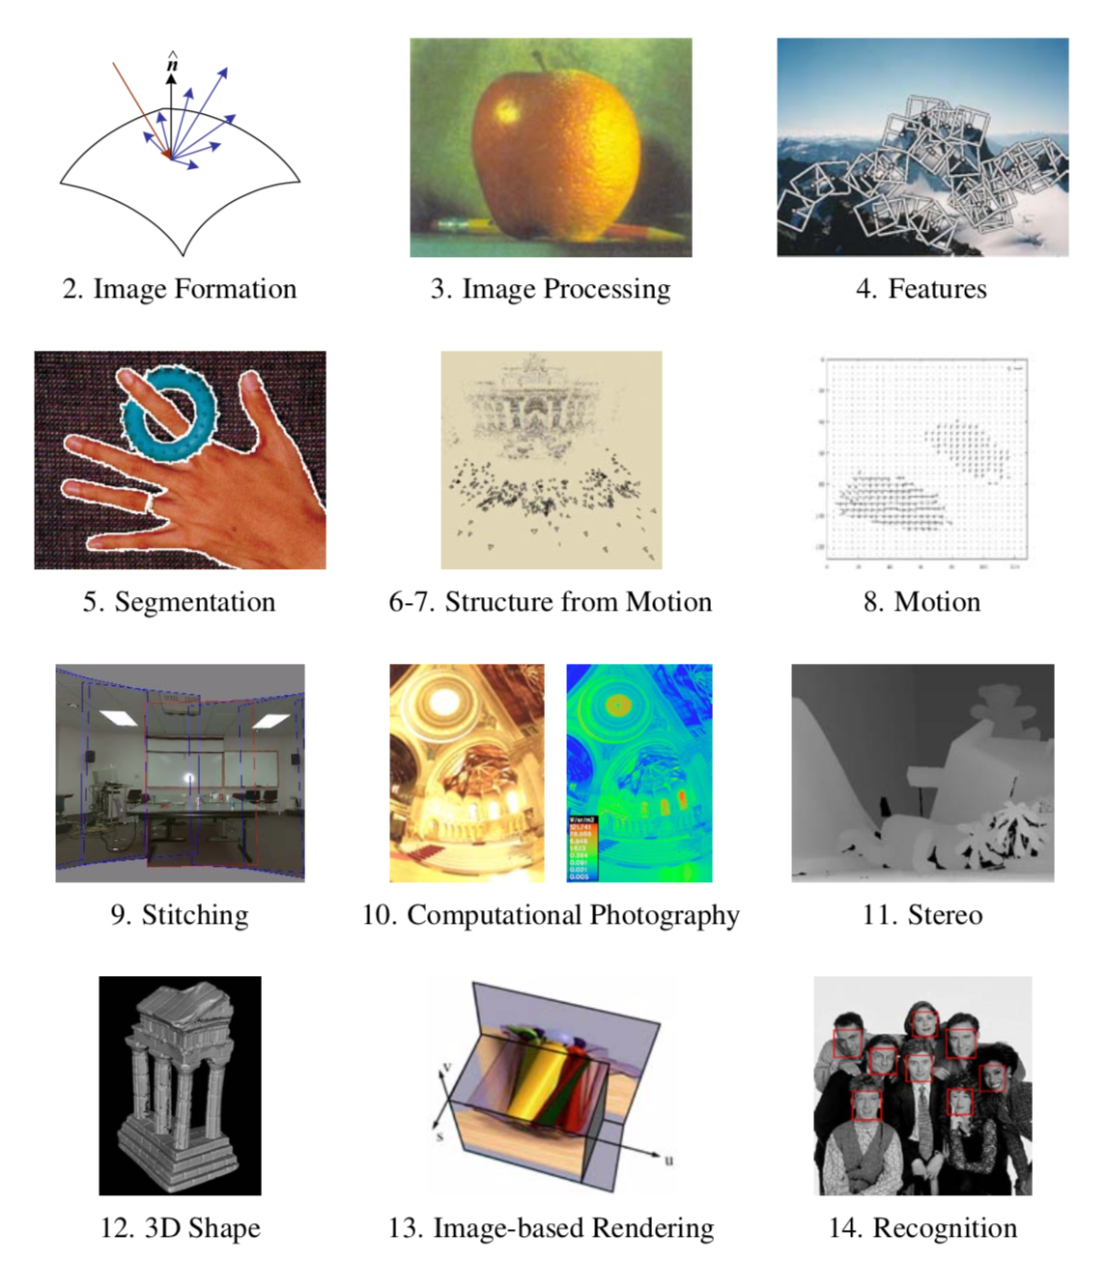

Slide 2
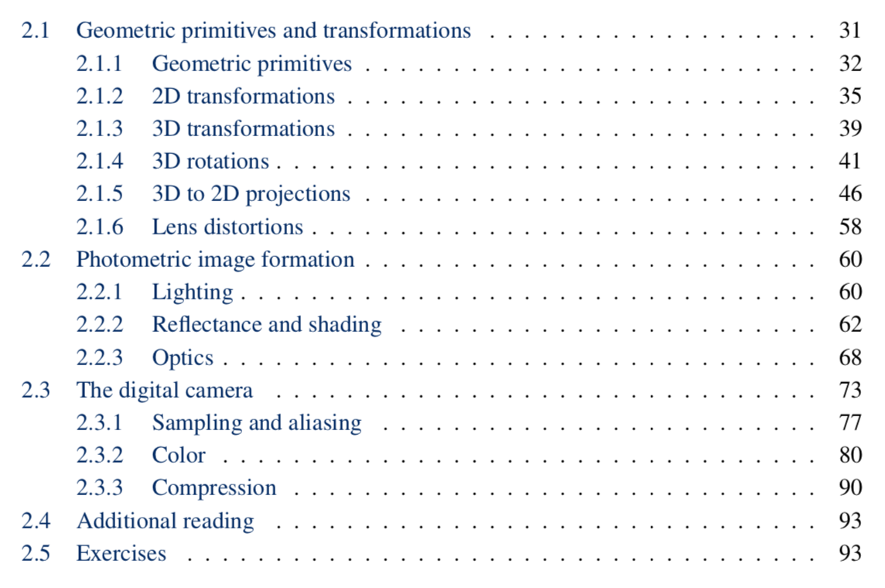
Image Formation

Slide 3
Image Formation

Slide 4
2.1.1 Geometric Primitives
2D points:
2D lines:
2D conics:
3D points:
3D planes:
3D lines:

Slide 5
2D Coordinate Frames & Points
2D coordinates x and y
Point p = (x, y)
j
p = (x,y)^{T}
i
o

Slide 6
2D Lines
Line l = (a, b, c)
Point p coincides with line iff ax + by = c
j
c
p=(x, y)^{T}
(a,b)^{T}
i

Slide 7
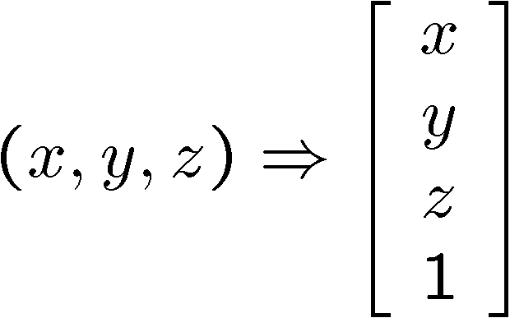
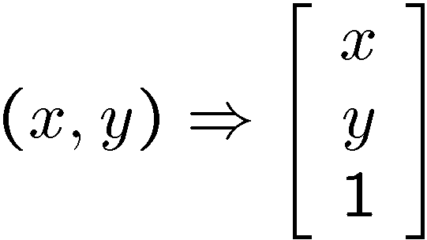
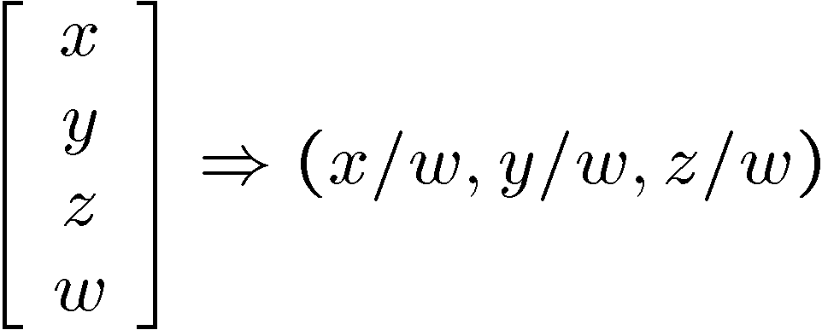
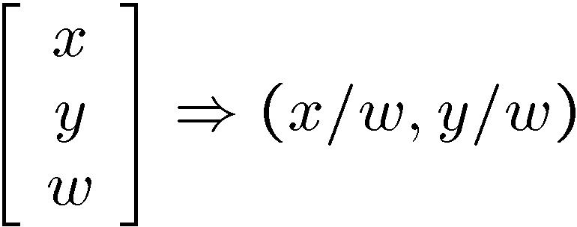
Homogeneous coordinates
Conversion
Converting to homogeneous coordinates
homogeneous image
coordinates
homogeneous scene
coordinates
Converting from homogeneous coordinates
Notes:
Append coordinate with value 1; proportional coordinate system

Slide 8
Homogeneous Coordinates
Uniform treatment of points and lines
Line-point incidence: l^{T}p=0
j
Stay the same when scaled:
c
p=(x,y,1)^{T}~(kx, ky, k)^{T}
(a,b)^{T}
l=(a, b, c)^{T}~(ka, kb, kc)^{T}
i

Slide 9
Join = cross product !
Join of two lines is a point: p=l₁ x l₂
Join of two points is a line: l=p₁ x p₂

Slide 10




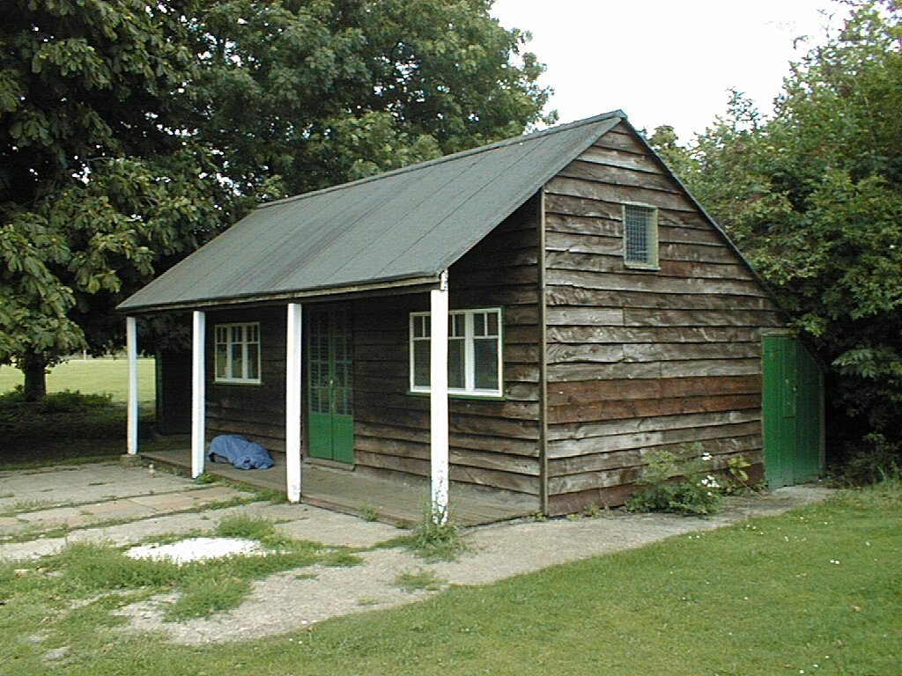
Automatic estimation of vanishing points and lines

Slide 11
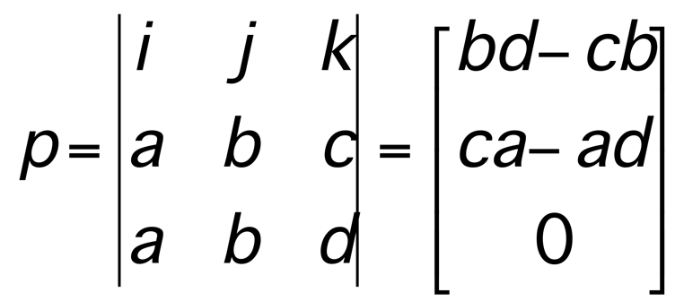
Joining two parallel lines ?
(a,b,c)
(a,b,c)
(a,b,d)

Slide 12
Points at Infinity !
(-b,a,0)^{T}
Line at infinity
l_{inf}=(0,0,1)^{T}
j
l=(a,b,c)^{T}
i
(-b,a,0)^{T}

Slide 13
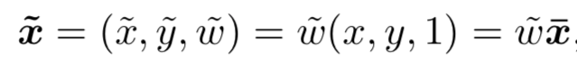
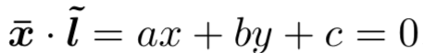
2.1.1 Geometric Primitives
homogeneous
2D points: (x,y),
2D lines:
2D conics:
3D points:
3D planes:
3D lines:

Slide 14
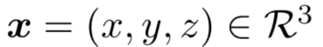
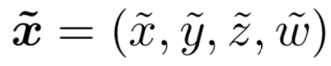
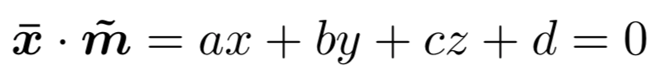
2.1.1 Geometric Primitives
homogeneous
augmented
2D points: (x,y),
2D lines:
2D conics:
3D points:
3D planes:
3D lines:

Slide 15
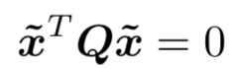
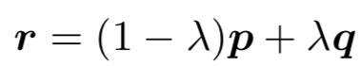
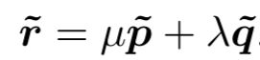
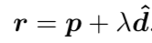
2.1.1 Geometric Primitives
homogeneous
augmented
2D points: (x, y),
2D lines:
2D conics:
3D points:
3D planes:
3D lines:
See Chapter 2.1.1 for conics, quadrics, 3D lines

Slide 16
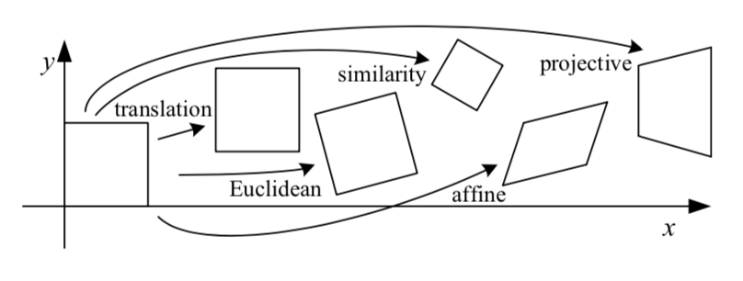
2.1.2: 2D Transformations

Slide 17

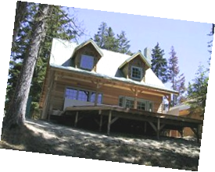
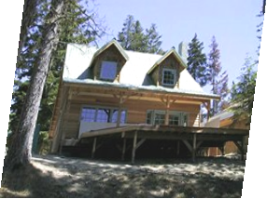
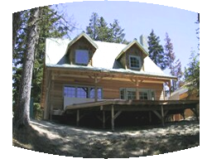
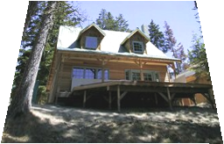
2.1.2: 2D Transformations
translation
rotation
aspect
affine
perspective
cylindrical
2D transformation slides adapted from CMU courses by Gkioulekas, Kitani

Slide 18
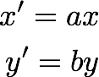

2D planar transformations

Slide 19

How would you implement scaling?
Scale
Each component multiplied by a scalar
Uniform scaling - same scalar for each component

Slide 20
What’s the effect of using different scale factors?
Scale
Each component multiplied by a scalar
Uniform scaling - same scalar for each component

Slide 21
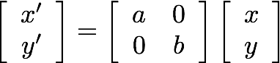
matrix representation of scaling:
Scale
scaling matrix S
Each component multiplied by a scalar
Uniform scaling - same scalar for each component

Slide 22
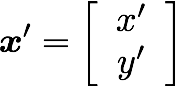
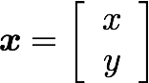
How would you implement rotation?
rotation around the origin

Slide 23
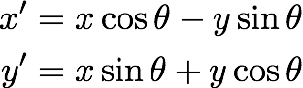
rotation around the origin

Slide 24
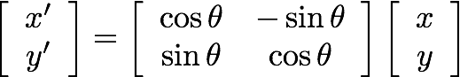
or in matrix form:
rotation around the origin
Rotation matrix:
Columns are unit vectors
Columns are mutually orthogonal
Inverse is transpose

Slide 25
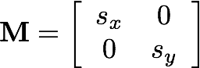
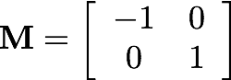
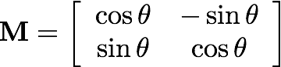
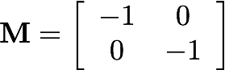
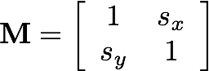
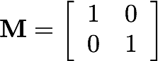
2D planar and linear transformations
Scale
Flip across y
Rotate
Flip across origin
Shear
Identity

Slide 26
2D translation
How would you implement translation?

Slide 27
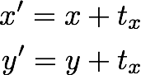
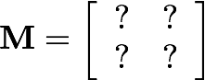
2D translation
What about matrix representation?

Slide 28
2D translation
What about matrix representation?
Not possible.

Slide 29
2D translation
What about matrix representation using homogenous coordinates?

Slide 30
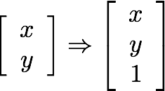
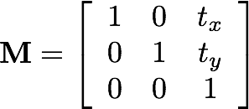
2D translation
What about matrix representation using augmented coordinates?

Slide 31
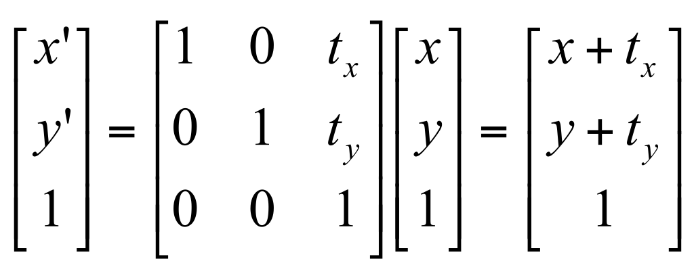
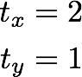
2D translation using homogeneous coordinates

Slide 32
2D Transformations in homogeneous coordinates

Slide 33
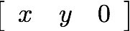
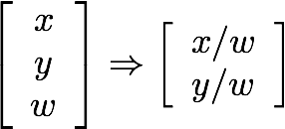
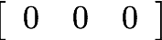
Reminder: Homogeneous coordinates
Conversion:
inhomogeneous → augmented/homogeneous
homogeneous → inhomogeneous
scale invariance
Special points:
point at infinity
undefined

Slide 34
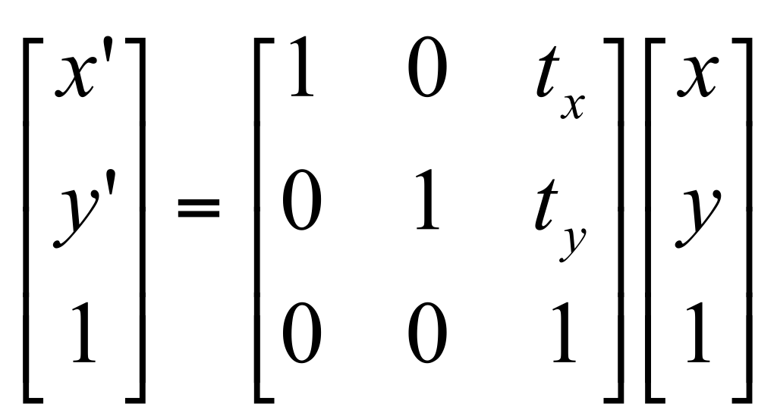
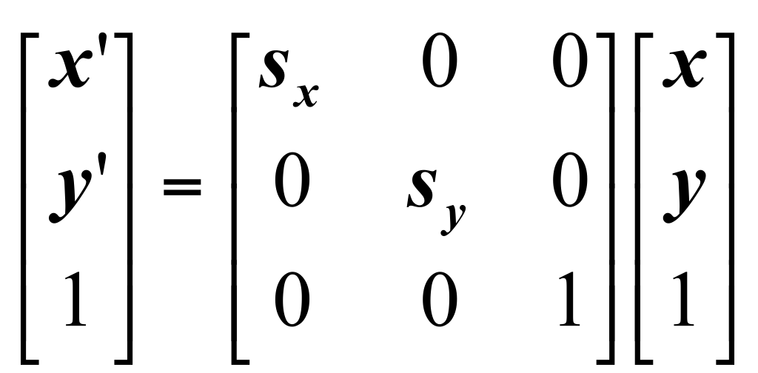
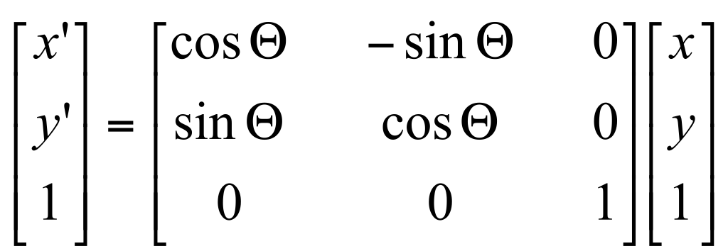
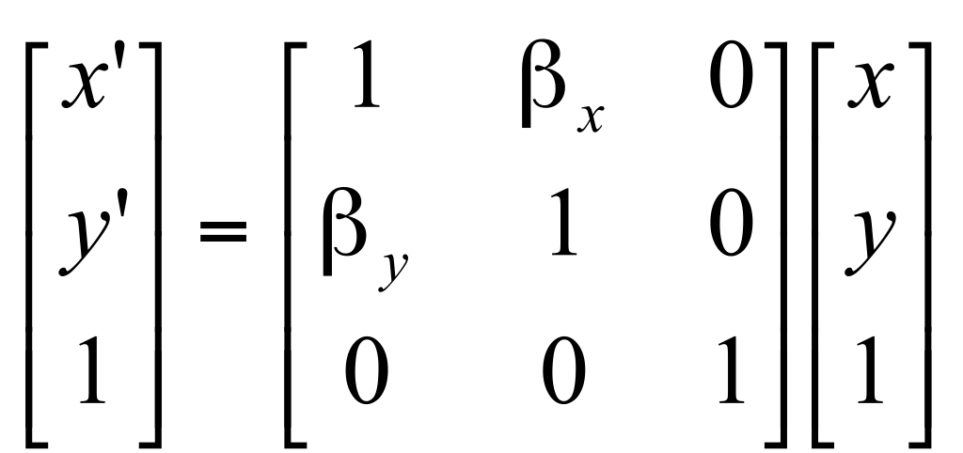
2D transformations
Re-write these transformations as 3x3 matrices:
?
translation
scaling
?
?
rotation
shearing

Slide 35
2D transformations
Re-write these transformations as 3x3 matrices:
translation
scaling
?
?
rotation
shearing

Slide 36
2D transformations
Re-write these transformations as 3x3 matrices:
translation
scaling
?
rotation
shearing

Slide 37
2D transformations
Re-write these transformations as 3x3 matrices:
translation
scaling
rotation
shearing

Slide 38
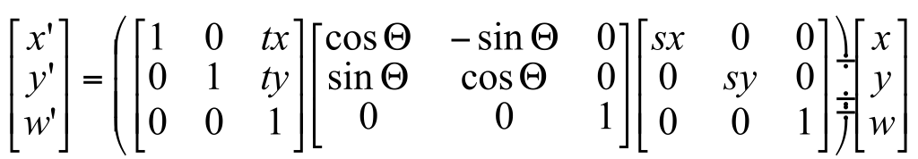
Matrix composition
Transformations can be combined by matrix multiplication:
p’ = ? ? ? p

Slide 39
Matrix composition
Transformations can be combined by matrix multiplication:
p’ = translation(t_{x},t_{y}) rotation(θ) scale(s,s) p
Does the multiplication order matter?

Slide 40
Classification of 2D transformations

Slide 41
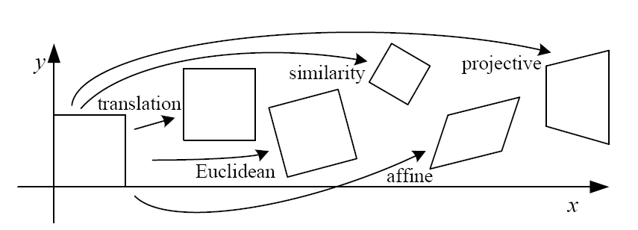
Classification of 2D transformations

Slide 42
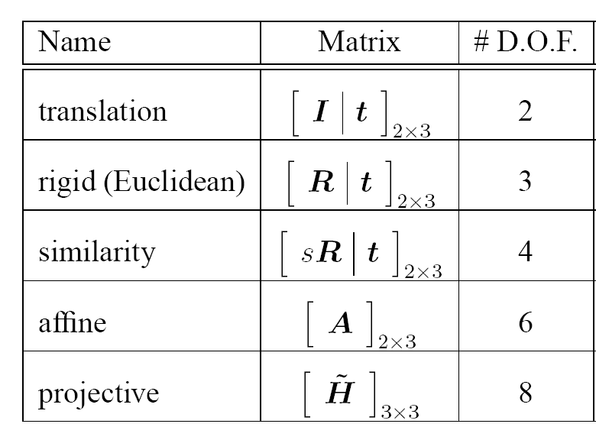
Classification of 2D transformations
?
?
?
?
?

Slide 43

Translation
Translation:
How many degrees of freedom?

Slide 44

Euclidean/Rigid
Euclidean (rigid):
rotation + translation
How many degrees of freedom?

Slide 45

Affine
Affine transform:
uniform scaling + shearing
+ rotation + translation
Are there any values that are related?

Slide 46

Affine transformations
Affine transformations are combinations of
arbitrary (4-DOF) linear transformations
+ translations
Properties of affine transformations:
origin does not necessarily map to origin
lines map to lines
parallel lines map to parallel lines
ratios are preserved
compositions of affine transforms are also affine transforms
Does the last coordinate w ever change?

Slide 47

Projective transformations
Projective transformations are combinations of
affine transformations;
+ projective wraps
Properties of projective transformations:
origin does not necessarily map to origin
lines map to lines
parallel lines do not necessarily map to parallel lines
ratios are not necessarily preserved
compositions of projective transforms are also projective transforms
How many degrees of freedom?
8 DOF: vectors (and therefore matrices) are defined up to scale)

Slide 48
Classification of 2D transformations
?
?
?
?
?

Slide 49
Classification of 2D transformations
2
3
4
6
8

Slide 50
2.1.3: 3D Transformations
Need a way to specify the six degrees-of-freedom of a rigid body.
Why are there 6 DOF?
A rigid body is a
collection of points
whose positions
relative to each
other can’t change
Fix one point,
three DOF
Fix second point,
two more DOF
(must maintain
distance constraint)
Third point adds
one more DOF,
for rotation
around line

Slide 51






Notations
Superscript references coordinate frame
^{A}P is coordinates of P in frame A
^{B}P is coordinates of P in frame B
Example :

Slide 52


Translation
Using augmented/homogeneous coordinates, translation is expressed as a matrix multiplication.
Translation is communicative

Slide 53


Rotation in homogeneous coordinates
Using homogeneous coordinates, rotation can be expressed as a matrix multiplication.
R is a rotation matrix:
Columns are unit vectors
Columns are mutually orthogonal
Inverse is transpose
Rotation is not communicative

Slide 54


3D Rigid transformations

Slide 55


3D Rigid transformations
Unified treatment using homogeneous coordinates.

Slide 56
Hierarchy of 3D Transforms
Subgroup Structure:
Translation (? DOF)
Rigid 3D (? DOF)
Affine (? DOF)
Projective (? DOF)

Slide 57
Hierarchy of 3D Transforms
Subgroup Structure:
Translation (3 DOF)
Rigid 3D (6 DOF)
Affine (12 DOF)
Projective (15 DOF)

Slide 58
2.1.5: 3D to 2D: Projection
3D world
2D image
Figures © Stephen E. Palmer, 2002

Slide 59


Orthographic Projection

Slide 60

Pinhole camera
f
c
f = focal length
c = center of the camera
Figure from Forsyth

Slide 61


Pre-history: the Camera obscura
Known during classical period in China and Greece (e.g. Mo-Ti, China, 470BC to 390BC)
Illustration of Camera Obscura
Freestanding camera obscura at UNC Chapel Hill
Photo by Seth Ilys

Slide 62

Camera Obscura used for Tracing
Lens Based Camera Obscura, 1568

Slide 63


First Photograph
Oldest surviving photograph
Took 8 hours on pewter plate
Photograph of the first photograph
Joseph Niepce, 1826
Stored at UT Austin
Niepce later teamed up with Daguerre, who eventually created Daguerrotypes

Slide 64

Projection can be tricky…
Slide source: Seitz

Slide 65

Projection can be tricky…
Slide source: Seitz

Slide 66

Notes:
Paris town hall

Slide 67


Slide 68


Slide 69


Slide 70

Camera and World Geometry
How tall is this woman?
How high is the camera?
What is the camera rotation?
What is the focal length of the camera?
Which ball is closer?

Slide 71
Pinhole Camera
Fundamental equation:
k
M
m
i
C
f
Q
q
O
j

Slide 72
Homogeneous Coordinates

Slide 73

We can see infinity !
Railroad: parallel lines
P=(0,0,1,0)^{T}
p=MP=(0,0,1)^{T}

Slide 74
Vanishing points and lines
Vanishing Point
Vanishing Point
o
o
Vanishing Line
Notes:
Go to board, sketch out various properties of vanishing points/lines
Parallel lines intersect at a point
The intersection of red lines and blue lines form a parallelogram
Sets of parallel lines on the same plane form a vanishing line
Sets of parallel planes form a vanishing line
Not all lines that intersect are parallel

Slide 75
Vanishing points and lines
Vertical vanishing
point
(at infinity)
Vanishing
point
Vanishing
point
Slide from Efros, Photo from Criminisi

Slide 76

Pixel coordinates in 2D
(0.5,0.5)
640
(u₀,v₀)
i
480
(640.5,480.5)
j

Slide 77
Intrinsic Calibration
skew
5 Degrees of Freedom !

Slide 78
Camera Pose
In order to apply the camera model, objects in the scene
must be expressed in camera coordinates.
Camera
Coordinates
World
Coordinates
Calibration target looks tilted from camera
viewpoint. This can be explained as a
difference in coordinate systems.

Slide 79
Projective Camera Matrix
5+6 DOF = 11 !

Slide 80
Projective Geometry
What is lost?
Length
Who is taller?
Which is closer?

Slide 81

Length and area are not preserved
A’
C’
B’
Figure by David Forsyth

Slide 82
Projective Geometry
What is lost?
Length
Angles
Parallel?
Perpendicular?

Slide 83
Projective Geometry
What is preserved?
Straight lines are still straight

Slide 84
Field of View (Zoom, focal length)

Slide 85


2.1.6 Radial Distortion
Corrected Barrel Distortion
Image from Martin Habbecke

